Slide 1
System of Units
The principle aspects of the scientific method are accurate measurement, selective analysis, and mathematical formulation. Note that the first and most important is accurate measurements. Measurement: is the process by which one can convert physical parameters to meaningful number. Instrument: may be defined as a device for determining the value or magnitude of a quantity or variable. The standard measure of each kind of physical quantity is the unit; the number of times the unit occurs in any given amount of the same quantity is the number of measure. With out the unit, the number of measure has no physical meaning.

Slide 2
Fundamental and Derived Units
To measure an unknown we must have acceptable unit standard for the property that is to be assessed. By choosing a small number of basic quantities as standards, we can define all the other in terms of these few. The basic units are called fundamentals, while all the others which can be expressed in terms of fundamental units are called derived units, and formed by multiplying or dividing fundamental units.

Slide 3
The primary fundamental units which most commonly used are length, mass, and time, while measurement of certain physical quantities in thermal, electrical, and illumination disciplines are also represented by fundamental units. These units are used only when these particular classes are involved, and they may therefore be defined as auxiliary fundamental units. Every derived unit originates from some physical law defining that unit. For example, the voltage [volt]:

Slide 7
Multiples and Submultiples of units The units in actual use are divided into submultiples for the purpose of measuring quantities smaller than the unit itself. Furthermore, multiples of units are designated and named so that measurement of quantities much larger than the unit is facilitated. Table(3) lists the decimal multiples and submultiples of units.

Slide 15
(1-1 to 1-13)

Slide 17
What are the advantages of Dimensional Analysis?
1.check validity of equations
2.form equations(without constants), etc.
3.It will be very helpful in exam also :) , you can opt the correct choice there
4.Basically it is very helpful in getting an idea about what actually an equation is if we don't know much about that formula

Slide 18
Standard of Measurements
A standard of measurement is a physical representation of a unit of measurement. Standard of measurement classified by their function and application in the following categories: 1. International standards 2. Primary standards 3. Secondary standards 4. Working standards

Slide 21
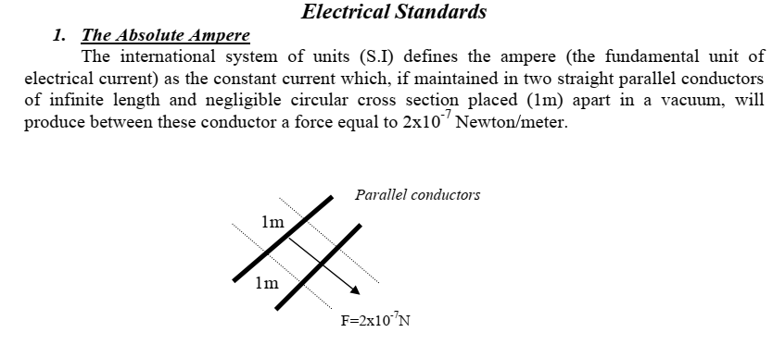

Slide 26
IEEE Standards: A slightly different type of standard is published and maintained by (Institute of Electrical and Electronics Engineers). evaluating various electronics systems and components such as: 1- Standard method for testing and evaluating attenuators. 2- Standards for specifying test equipment, like IEEE standard addresses the laboratory oscilloscope and specifies the controls, functions, etc. 3- Various standards concerning the safety of wiring for power plants, ships, industrial buildings.

